Slide 1

NAÏVE BAYES CLASSIFIER ALGORITHM
■ DEFINITION
Naïve Bayes algorithm is a supervised learning algorithm, which is based on Bayes theorem and used for solving classification problems and it is one of the simple and most effective Classification algorithms which helps in building the fast machine learning models that can make quick predictions on the basis of the probability of an object.
Some popular examples of Naïve Bayes Algorithm are spam filtration, medical data analysis, and classifying articles.
Naïve Bayes
Bayes Theorem Formula:-
Where,
P(A|B) is Posterior probability, (B|A) is Likelihood probability, (A) is Prior Probability and P(B) is Marginal Probability.
Naïve
Bayes

Slide 2
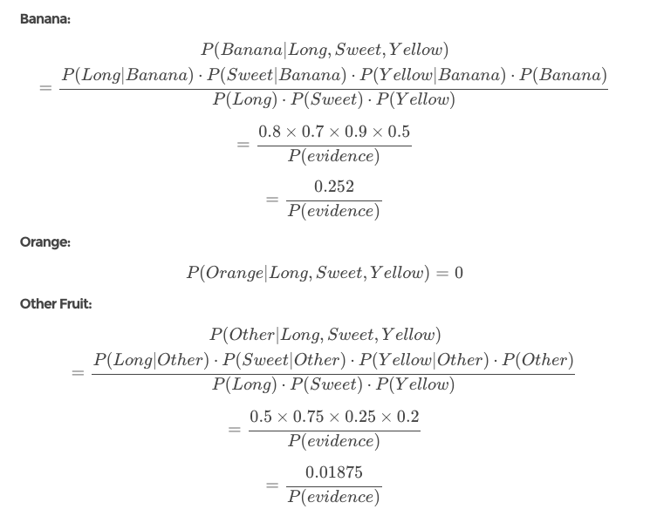
ALGORITHM
Step 1: Create a frequency table for all the features against the different classes.
Step 2: Draw the likelihood table for the features against the classes.
Step 3: Calculate the conditional probabilities for all the classes.
Step 4: Calculate.
Example:-
NAME | YELLOW | SWEET | LONG | TOTAL FRUITS
MANGO | 350 | 450 | 0 | 650
BANANA | 400 | 300 | 350 | 400
OTHERS | 50 | 100 | 50 | 150
TOTAL | 800 | 850 | 400 | 1200
50% of the fruits are bananas
30% are oranges
20% are other fruits
Based on our training set we can also say the following:
From 500 bananas 400 (0.8) are Long, 350 (0.7) are Sweet and 450 (0.9) are Yellow
Out of 300 oranges 0 are Long, 150 (0.5) are Sweet and 300 (1) are Yellow
From the remaining 200 fruits, 100 (0.5) are Long, 150 (0.75) are Sweet and 50 (0.25) are Yellow
In this case, based on the higher score 0.01875 < 0.252 we can assume this Long, Sweet and Yellow fruit is, in fact, a Banana.

Slide 3
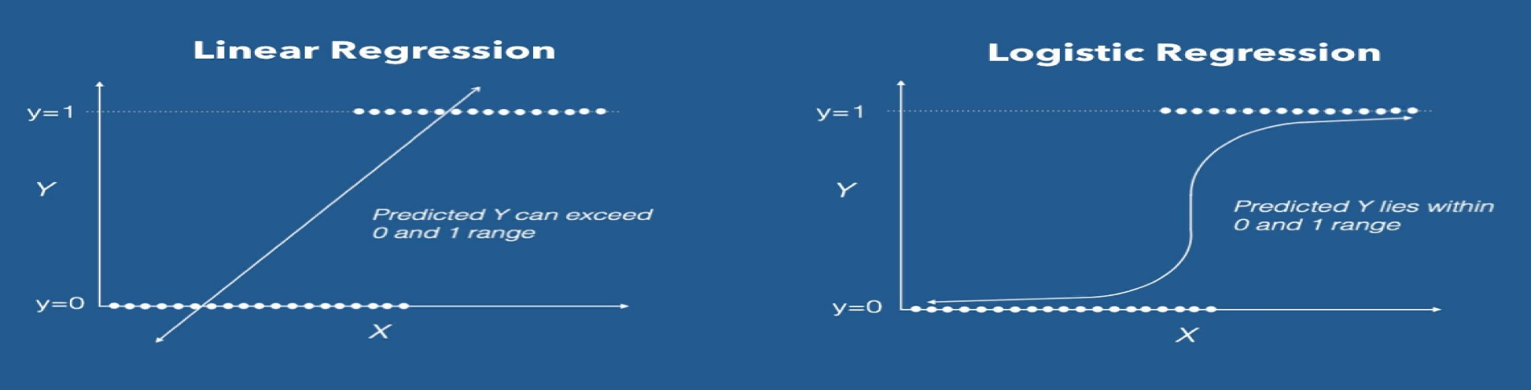


LOGISTIC REGRESSION
It’s a Machine Learning algorithm which is used for the classification problems, it is a predictive analysis algorithm and based on the concept of probability.
Logistic Regression
Regression
It is one concept in statistics i.e. measure of the relation between the mean value of one variable (e.g. output) and corresponding values of other variables.
Equation:
The Logistic regression equation can be obtained from the Linear Regression equation. The mathematical steps to get Logistic Regression equations are given below:
• We know the equation of the straight line can be written as:
• In Logistic Regression y can be between 0 and 1 only, so for this let's divide the above equation by (1-y):
• But we need range between -[infinity] to +[infinity], then take logarithm of the equation it will become:
This equation is the final equation for Logistic Regression.

Slide 4

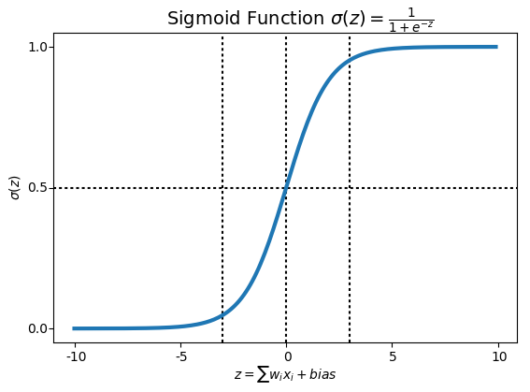
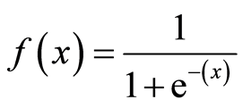
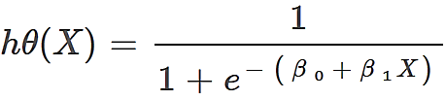
In Logistic regression, instead of fitting a regression line, we fit an "S" shaped logistic function, which predicts two maximum values (0 or 1). It’s the ‘Sigmoid function’ or also known as the ‘logistic function’.
The hypothesis of logistic regression tends it to limit the cost function between 0 and 1. Therefore linear functions fail to represent it as it can have a value greater than 1 or less than 0 which is not possible as per the hypothesis of logistic regression.
Logistic regression hypothesis expectation
• Sigmoid Function:-
• Hypothesis Representation:-
When using linear regression we used a formula of the hypothesis i.e.
hΘ(x) = β₀ + β₁X
For logistic regression we are going to modify it a little bit i.e.
σ(Z) = σ(β₀ + β₁X)
We have expected that our hypothesis will give values between 0 and 1.
Z = β₀ + β₁X
hΘ(x) = sigmoid(Z)
i.e. hΘ(x) = 1/(1 + e^-(β₀ + β₁X)
Formula of a sigmoid function
The Hypothesis of logistic regression

Slide 5
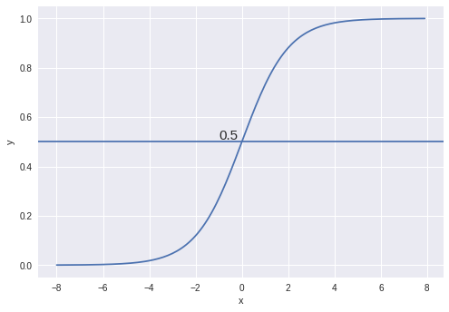
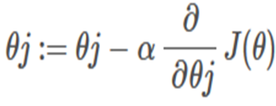
• Decision Boundary:-
• Gradient Descent:-
Now the question arises, how do we reduce the cost value. Well, this can be done by using Gradient Descent. The main goal of Gradient descent is to minimize the cost value. i.e. min J(θ).
Now to minimize our cost function we need to run the gradient descent function on each parameter i.e.
Here, we have 2 classes. We basically decide with a threshold value above which we classify values into Class 1 and of the value goes below the threshold then we classify it in Class 2.
ALGORITHM
• Cost Function:-
To implement the Logistic Regression, we will use these steps:
Data Pre-processing step.
Fitting Logistic Regression to the Training set.
Predicting the test result.
Test accuracy of the result(Creation of Confusion matrix).
Visualizing the test set result.
For logistic regression, the Cost function
is defined as:
−log(hθ(x)) if y = 1
−log(1−hθ(x)) if y = 0
the cost function represents optimization objective i.e. we create a cost function and minimize it so that we can develop an accurate model with minimum error.

Slide 6
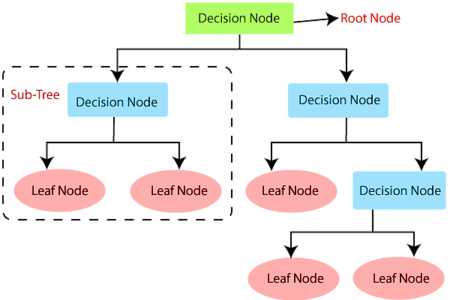
DECISION TREE
Decision Tree:- Decision tree is a basic classification method. It is supervised learning method. Decision tree used when response variable is categorical. Decision tree has tree like structure based model which describes classification process based on input feature. Input variables are any types like discrete, continuous etc.
Algorithm
Step-1: Begin the tree with the root node, which contains the complete dataset.
Step-2: Find the best attribute in the dataset using Attribute Selection Measure (ASM).
Step-3: Divide the root node into subsets that contains possible values for the best attributes.
Step-4: Generate the decision tree node, which contains the best attribute.
Step-5: Recursively make new decision trees using the subsets of the dataset created in step -3. Continue this process until a stage is reached where you cannot further classify the nodes and called the final node as a leaf node.

Slide 7
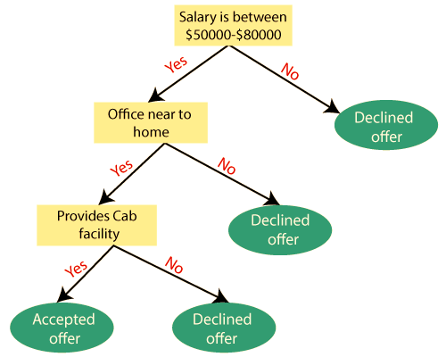
Example: Suppose there is a candidate who has a job offer and wants to decide whether he should accept the offer or Not. So, to solve this problem, the decision tree starts with the root node (Salary attribute by ASM). The root node splits further into the next decision node (distance from the office) and one leaf node based on the corresponding labels. The next decision node further gets split into one decision node (Cab facility) and one leaf node. Finally, the decision node splits into two leaf nodes (Accepted offers and Declined offer). Consider the below diagram:

Slide 8
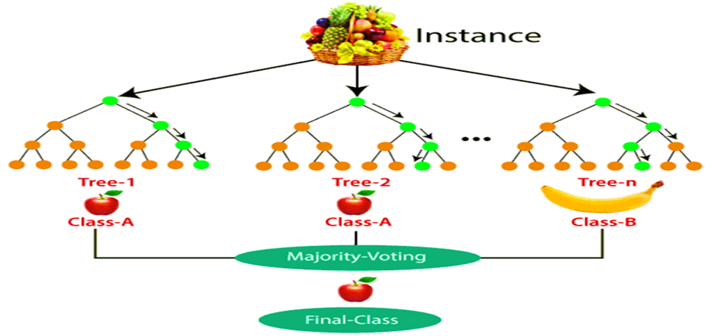
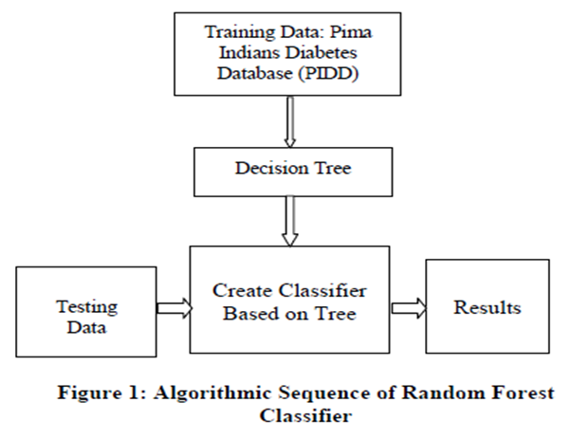
RANDOM FOREST
Random forest is a popular machine learning algorithm that belongs to the supervised learning technique. It is based on the concept of ensemble learning, which is a process of combining multiple classifiers to solve the complex problem & improve the performance of the model.
There are two major parts in Random Forest :-
Bagging.
Boosting.
ALGORITHM
Step 1:- Select random K data point from the training set.
Step 2:- Build the decision trees associated with the selected data point(Subset).
Step 3:- Choose the number of N for decision trees that you want
to build.
Step 4:- Repeat Step 1 & 2.
Step 5:- For the new data point, find the predictions of each decision tree, and assign the new data points to the category that wins the majority votes.
EXAMPLE

Slide 9
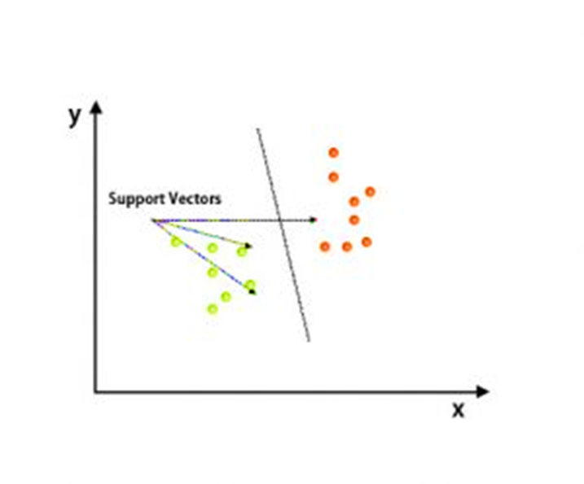
SUPPORT VECTOR MACHINE (SVM)
What is Support Vector Machine?
“Support Vector Machine” (SVM) is a supervised machine learning algorithm which can be used for both classification or regression challenges. However, it is mostly used in classification problems. In the SVM algorithm, we plot each data item as a point in n-dimensional space (where n is number of features you have) with the value of each feature being the value of a particular coordinate. Then, we perform classification by finding the hyper-plane that differentiates the two classes very well (look at the below snapshot).
ALGORITHM
Step1: Data Pre-processing step.
Step2: Fitting the SVM classifier to the training set.
Step3: Predicting the test set result.
Step4: Creating the confusion matrix.
Step5: Visualizing the training set result.
Step6: Visualizing the test set result

Slide 10
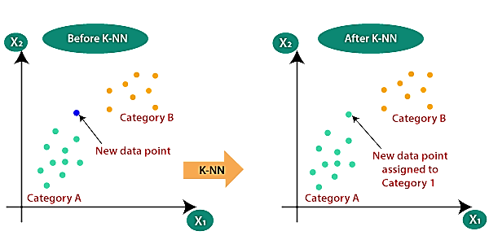
K-NEAREST NEIGHBORS (KNN)
KNN is a method which is used for classifying objects based on closest training examples in the feature space. KNN is the most basic type of instance-based learning or lazy learning. It assumes all instances are points in n-dimensional space. A distance measure is needed to determine the “closeness” of instances. KNN classifies an instance by finding its nearest neighbours and picking the most popular class among the neighbours.
Suppose there are two categories, i.e., Category A and Category B, and we have a new data point x1, so this data point will lie in which of these categories. To solve this type of problem, we need a K-NN algorithm. With the help of K-NN, we can easily identify the category or class of a particular dataset.
● ALGORITHM
I. Take a sample dataset of n columns and m rows named as R. In which n-1th columns are the input vector nth and column is the output vector. II. Take a test dataset of n-1 attributes and Y rows named as P. III. Find the Euclidean distance between every S and T by the help of formula Euclian Distance=〖 √∑_(i=1)^y▒∑_(j=1)^m▒∑_(l=11)^(n-1)▒(R(j,l)-P(i,l)) 〗^2 IV. Then, Decide a random value of K. K is the no. of nearest neighbours. V. Then with the help of these minimum distance and Euclidean distance find out the nth column of each. VI. Find out the same output values.

Slide 11
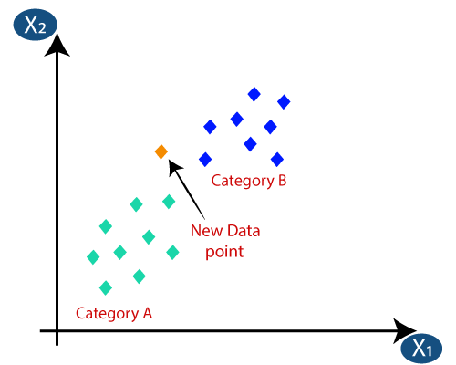
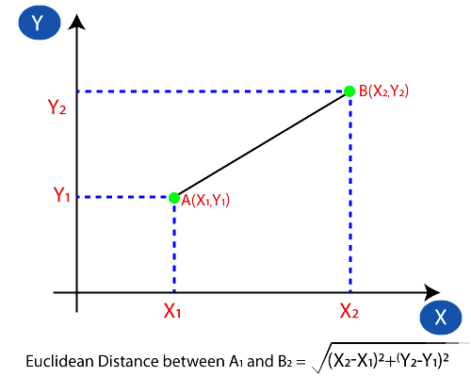
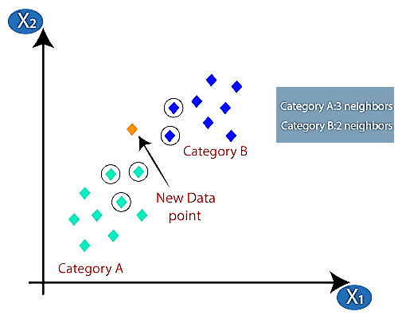
● HOW DOES KNN WORK
Suppose we have a new data point and we need to put it in the required category.
• Firstly, we will choose the number of neighbours, so we will choose the k=5.
• Next, we will calculate the Euclidean distance between the data points. The Euclidean distance is the distance between two points, which we have already studied in geometry. It can be calculated as:
• By calculating the Euclidean distance we got the nearest neighbours, as three nearest neighbours in category A and two nearest neighbours in category B.
Consider the image:
As we can see the 3 nearest neighbours are from category A. Hence this new data point must belong to category A.

Slide 12
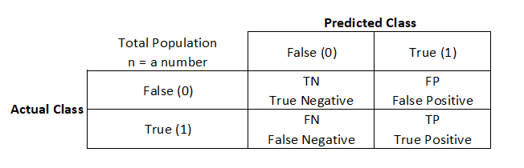
WORK IMPLEMENTATION
Dataset Used :-
The PIMA Indian Diabetes Dataset has been used in this study, provided by the UCI Machine Learning Repository.
The dataset has been originally collected from the National Institute of Diabetes and Digestive and Kidney Diseases.
This dataset has 768 patient’s data where all the patients are female and at least 21 years old.
The number of true cases are 268 (34.90%) and the number of false cases are 500 (65.10%), respectively.
Fields description:
•Number of times pregnant
•Plasma glucose concentration a
2 hours in an oral glucose tolerance test
•Diastolic blood pressure (mm Hg)
•Triceps skin fold thickness (mm)
•2-Hour serum insulin (mu U/ml)
•Body mass index (weight in kg/(height in m)^2)
•Diabetes pedigree function
•Age (years)
•Class variable (1:positive for diabetes, 0: negative for diabetes)
CONFUSION MATRIX

Slide 13
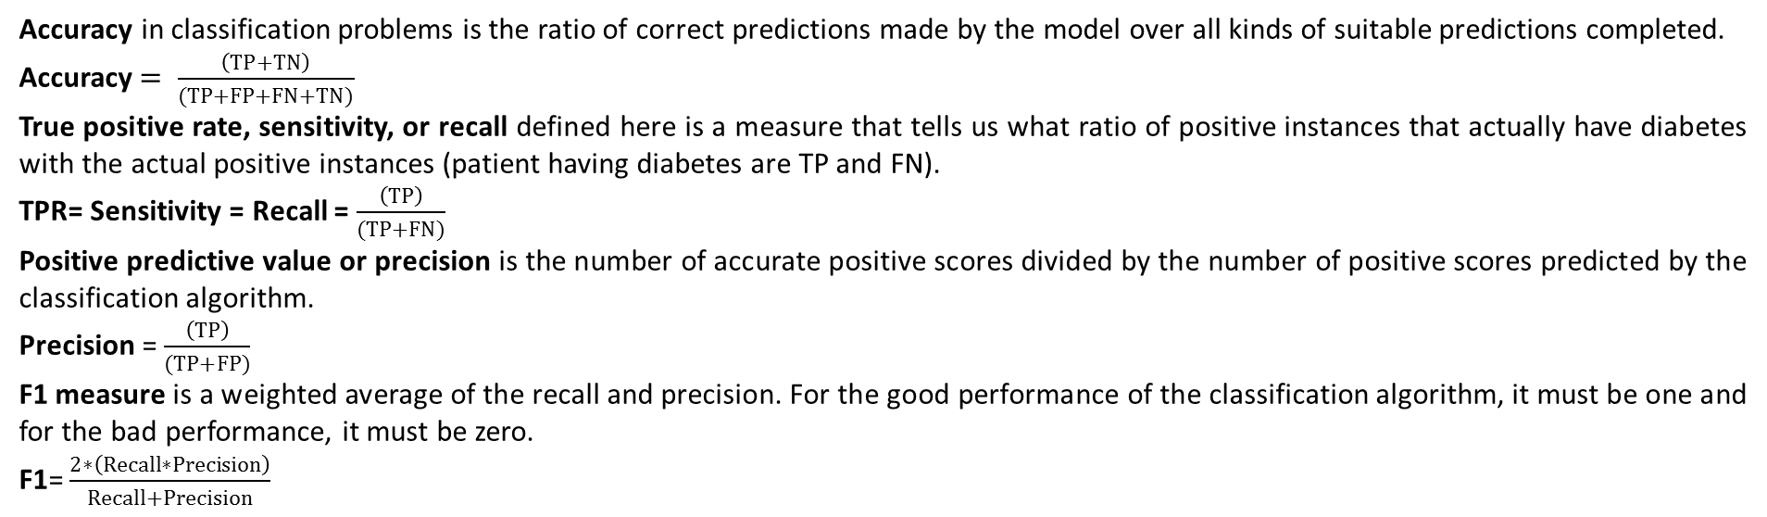
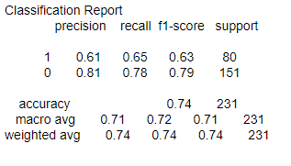
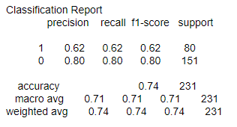
In this experiment, we’ve planned to conduct different analysis to evaluate the two machine learning classification algorithms for diabetes prediction. We split the diabetes data set into two parts where the training set contains 69.92% and the test set contains the remaining 30.08% of the data
NAÏVE-BAYES
The Naïve-Bayes and Logistic Regression classifiers shows the accuracy level of nearly 74%, more precisely 0.7359(Naïve-Bayes) and 0.7403(Logistic Regression) which indicates that the performance of these techniques are pretty well.
LOGISTIC REGRESSION

Slide 14
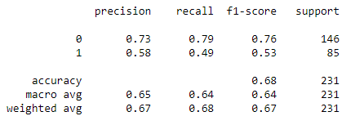
WORK IMPLEMENTATION OF DECISION TREE
After applying decision tree technique with the PIMA Indian dataset we get the value of True positive=115, True negative=42,False positive=31, False negative=43.
The decision tree classifier shows the accuracy level of nearly 68%, more precisely 0.6796536796536796 which indicates that the performance of these techniques are pretty well.
CLASSIFICATION REPORT OF DECISION TREE

Slide 15
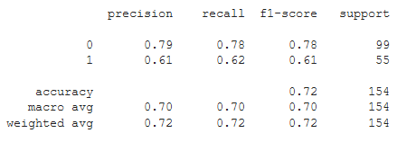

WORK IMPLEMENTATION OF RANDOM FOREST
The dimensions of the dataset are 768 rows and nine columns. Features selected for the model is glucose and blood pressure. Son the confusion matrix is used to predict the accuracy of our model. a)F(0,0)-False Negative b)F(0,1)-False Positive c)F(1,0)-True Negative d)F(1,1)-True Positive.
Test Result for Diabetic
Number of times pregnant: 6
Plasma glucose concentration a 2 hours in an oral glucose tolerance test: 148
Diastolic blood pressure (mm Hg): 72
Triceps skin fold thickness (mm): 35
2-Hour serum insulin (mu U/ml): 0
Body mass index (weight in kg/(height in m)^2): 33.6000
Diabetes pedigree function: 0.6270
Age (years): 50
Testing with Neural Network:
There are 100 % chances that person is diabetic.
So, Neural Network Considering data as diabetic.
Testing with Random Forest:
There are 96.7 % chances that person is diabetic.
So, Random Forest Considering data as diabetic.
The random forest classifier shows the accuracy level of nearly 72%, more precisely 0.720779220 which indicates that the performance of these techniques was very good.

Slide 16
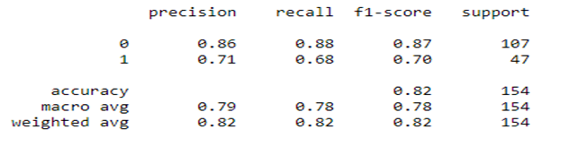
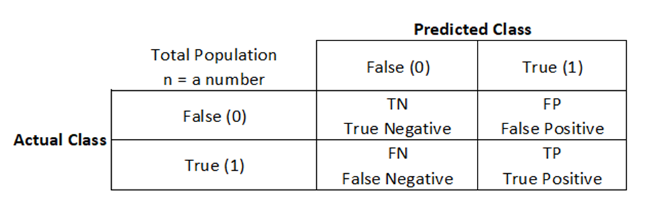
WORK IMPLEMENTATION OF SVM
Dataset Used :-
The PIMA Indian Diabetes Dataset has been used in this study, provided by the UCI Machine Learning Repository.
The dataset has been originally collected from the National Institute of Diabetes and Digestive and Kidney Diseases.
This dataset has 768 patient’s data where all the patients are female and at least 21 years old.
The number of true cases are 268 (34.90%) and the number of false cases are 500 (65.10%), respectively.
CONFUSION MATRIX
The Support Vector Machine(SVM) classifiers shows the accuracy level of nearly 79%, more precisely 0.79115141413121 which indicates that the performance of these techniques are pretty well.

Slide 17
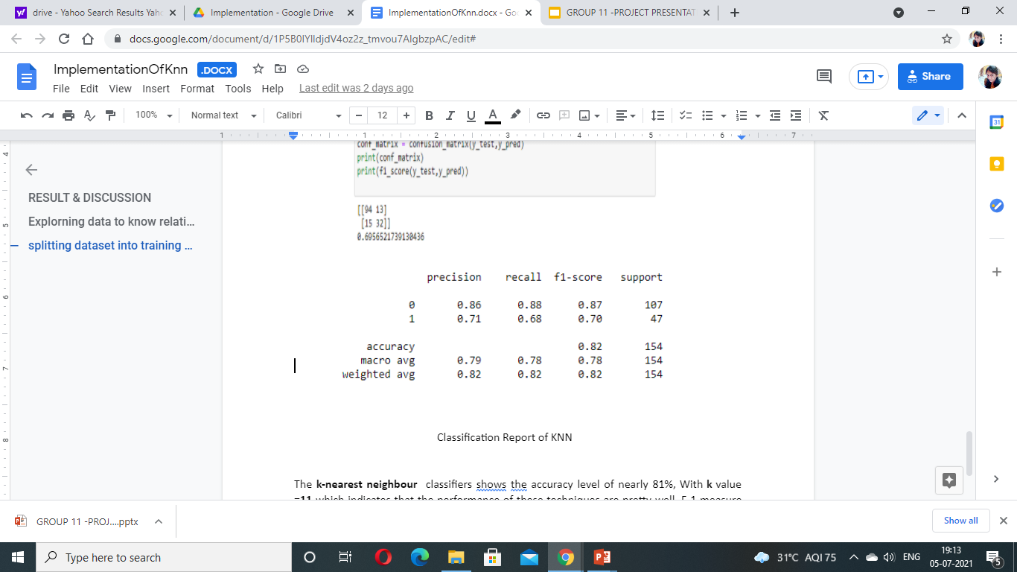
WORK IMPLEMENTATION OF KNN
After applying KNN with the PIMA Indian dataset we get the value of True positive =94,True negative=32,False positive=13,False negative=15. F1_score=69%.
ACTUAL VALUES
P R E D I T E D V A L U E S
POSITIVE(1)
NEGATIVE(0)
TP 94 | FP 13
FN 15 | TN 32
POSITIVE(1)
NEGATIVE(0)
The K- NEAREST NEIGHBOR classifiers shows the accuracy level of nearly 82%, more precisely 0.81818181818182 with k value=11,which indicates that the performance of these techniques are pretty well.

Slide 18
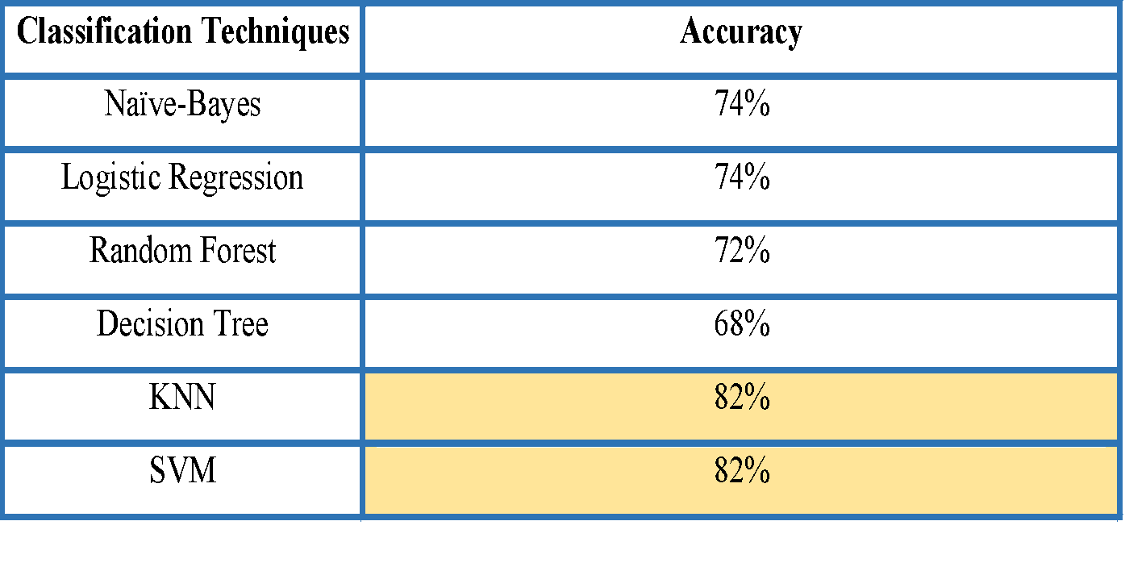
CONCLUSION
We have performed the study on six machine learning classifiers and experimental results show that the highest classification accuracy amongst them is 82% which we’ve got from SVM and KNN classification technique.

Slide 19
THANK YOU
?
ANY QUESTIONS

